Slide 1
In-class Exercise 18 - Compression
Dhiren Gupta
-800902466

Slide 2
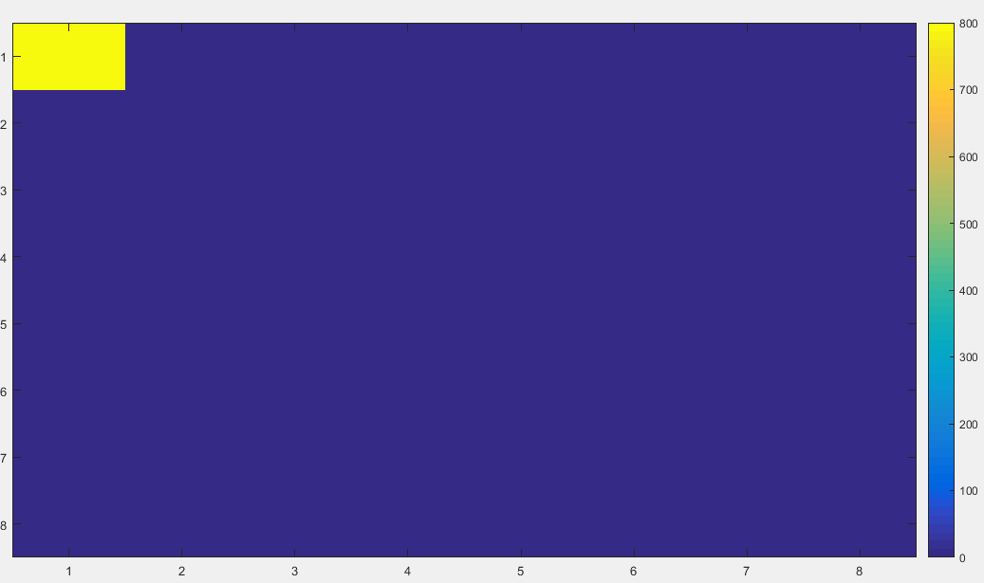
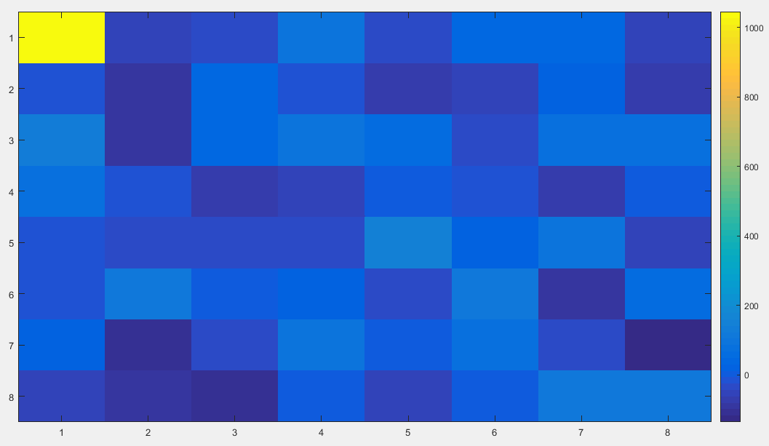
Visualization of DCT 8*8
All 100’s
Random

Slide 3

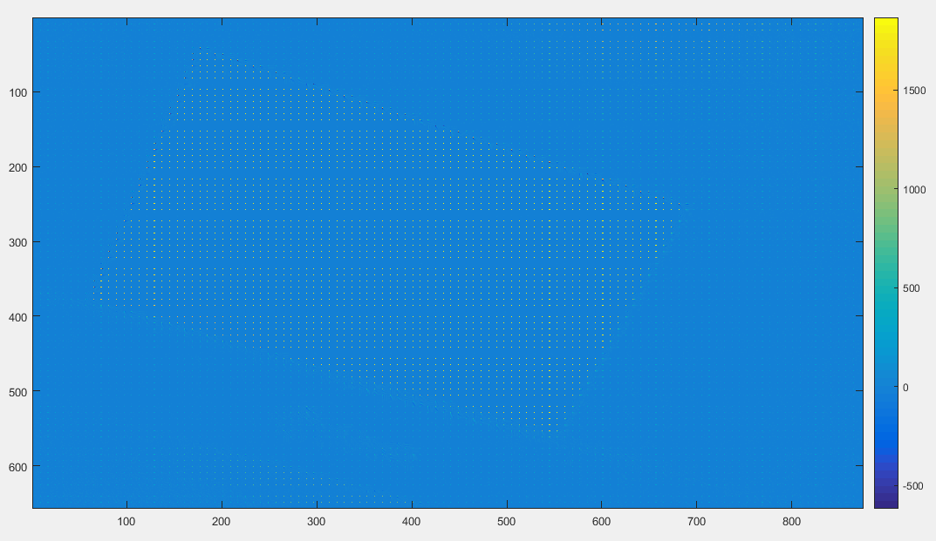
Visualization of DCT of Input image
Input Image
Output Image

Slide 4
Thank You

